Slide 1
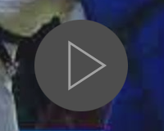
Presentation Instructions
Move from slide to slide using the up and down arrows on your keyboard.
Each slide has a narration identified by the speaker Icon. Click on it to hear the Commissions comments for the points on each slide.
Click on the play button
to watch the videos

Slide 2
Referee Webinar Series- #1-Purpose and Process
Judo BC –Referee Commission

Slide 3
Series Objectives
Highlight the qualities and characteristics of an effective referee.
Outline the purpose and priorites of the referee team
Set out the process of conducting a match
Address topics selected by survey participants

Slide 4
Why do you want to referee?
Contribute to the judo community
Continue to participate in judo
Support club activities
Improve understanding of competition rules and how they are applied
Meet other judoka and travel

Slide 5
Things to consider...
Refereeing is a different skill
Refereeing takes time & resources
Referees practice and learn differently
There will be adversity

Slide 6
Referees are..
Judoka at heart
Interested and objective
Patient
Open and fair-minded
Receptive to feedback and growth-oriented
Confident
Humble

Slide 7
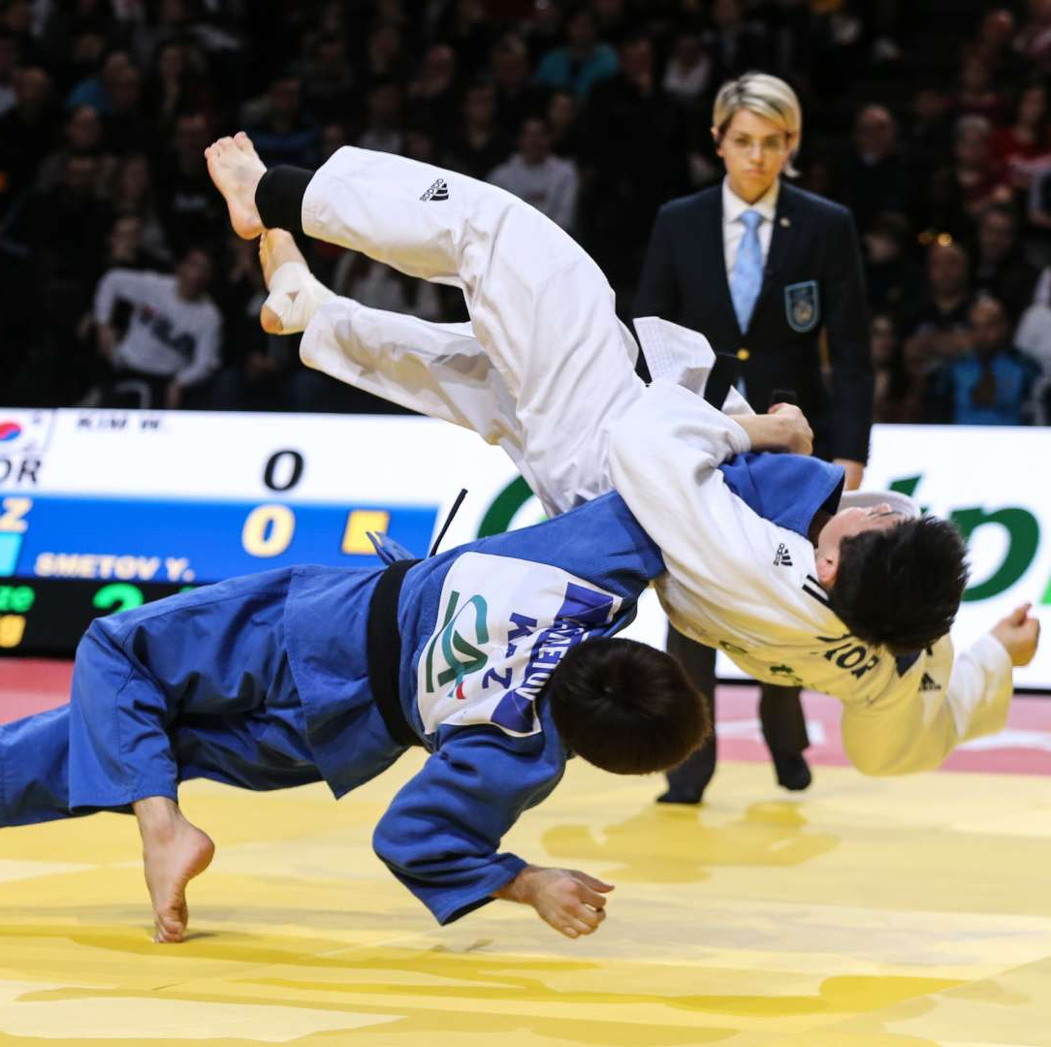
A referee's purpose...
Conduct a safe and high-quality judo match.
"Let it be a good match, and if it's not, let it be short!"

Slide 8
A referee's priorities
Athlete Safety
Contest Fairness
Quality Control

Slide 9
Athlete Safety
Conditions
Actions
Movement

Slide 10
Athlete safety
What is the athlete safety concern in this contest?
When does the referee know there is a problem?
How does she communicate this with the rest of the referee team?
What is the result?

Slide 11
Contest Fairness
Athletes
Judo Action

Slide 12
Contest Fairness
Despite the score at the 20 sec. Mark, it became clear as the match progressed that only one fighter wanted to fight? What evidence did you see of this?
What drove white's actions that lead to penalties? Was she trying to take unfair advantage or trying to avoid of her opponent?
At the 1:16 mark remaining, athlete safety pops up again as an issue. Would you have stopped the match earlier? Why or why not?

Slide 13
Quality Control
Technique
Attitude
Spirit
"Let it be a good match, and if it's not, let it be short!"

Slide 14
Quality Control
From a judo quality perspective how would you grade this match? A, B, or less? Why?
This match should have been much shorter. Why?
Why do you think it lasted as long as it did? What do you think was running through the referee's head or maybe his earpiece? Why?
Was white's approach different than the white fighter in the prior match?

Slide 15
What's next?

